Slide 1


Module 1 : Final Project
By: Payam Abbasi
04/27/2020

Slide 2
The Deliverables
Jupyter Notebook √
README.md file √
PowerPoint Slides √
A Blog Post √

Slide 3






Problem Statement
Comedy?
Drama?
Action?
What type of films are currently doing the best at the box office?
Horror?
Animation?

Slide 4


The Dataset

Slide 5
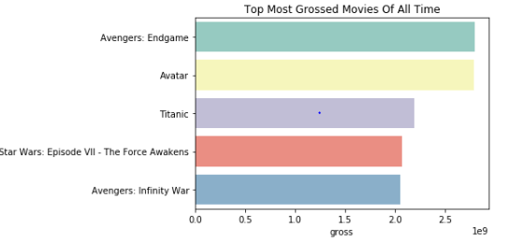





Top 5 Grossing movies of all time
2019 : PG-13
2009 : PG-13
1997 : PG-13
2015 : PG-13
2018 : PG-13
$2,797,800,564
$2,787,965,087
$2,186,772,302
$2,066,960,090
$2,048,359,754

Slide 6

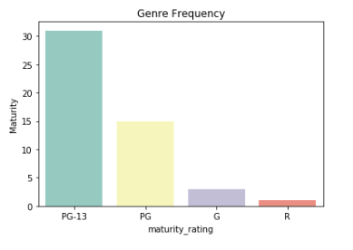



What maturity rating is the most watched?
√

Slide 7

Why Rated PG-13?
Young
Men
Old
Female

Slide 8
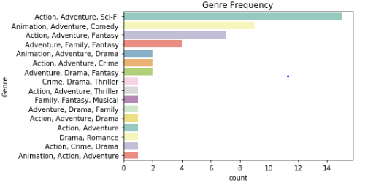
What genres do most people enjoy watching?

Slide 9

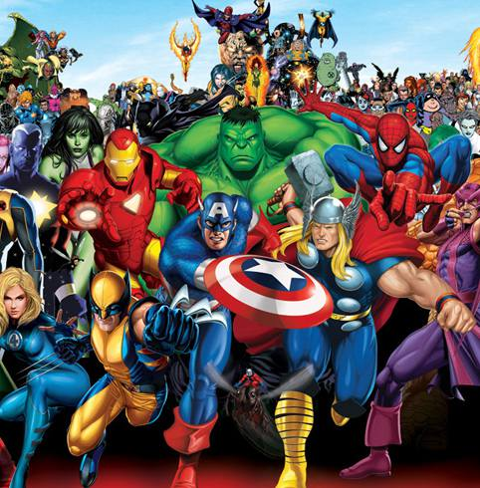
$$$ Why Action & Adventure? $$$
Keeps you on the edge!
We want to be them!

Slide 10
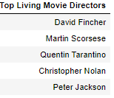
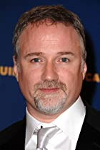

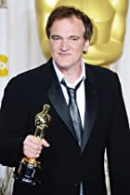

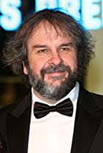
Top 5 Living Directors

Slide 11
Maturity Rating PG-13 Genre Adventure/Action top 5 directors 1. David Fincher 2. Martin Scorses 3. Quentin Tarantino 4. Christopher Nolan 5. Peter Jackson
What to invest in?

Slide 12

Future Work
Budget Vs. Profit
Top Grossing Living Actors and Actresses
ROI (Rate On Investment)

Slide 13

Any questions?

